Slide 1

“Criminal database management system”

Slide 2
IT VEDANT
DATA SCIENCE AND DATA ANALYTICS
Name – Simran Sabastian Tribhuvan
SQL Project

Slide 3
Introduction
The Criminal Database Management System (CDMS) is a specialized application designed to streamline the process of managing and analyzing data related to criminal activities. Its primary purpose is to provide a centralized platform for law enforcement agencies, judiciary bodies, and other stakeholders to efficiently store, access, and share crucial information on criminals, cases, offenses, victims, and court proceedings.
By integrating advanced database technologies, the CDMS enables the digitization of records, making it easier to track offenders, analyze crime patterns, and ensure smooth coordination between various departments. This system not only enhances the efficiency of investigations but also plays a critical role in improving public safety and ensuring justice.
.

Slide 4
Objective
Centralized storage of criminal records and case details.
Quick and efficient access to information.
Streamlined case tracking from registration to resolution.
Crime trend analysis for prevention strategies.
Secure and role-based access to data.
Automation of manual processes to save time.
Enhanced collaboration between law enforcement and judiciary.
Real-time updates for effective decision-making.
Improved transparency and accountability.
Optimized resource allocation for investigations.
Data security and confidentiality.
Support for legal and judicial proceedings

Slide 5
Problem Statement
Find the details of all criminals who have committed 'Theft’.
Retrieve all cases where the status is 'Open’.
Get the names of all police officers who are assigned to the 'Fraud Division’.
List all the criminals who are assigned to the 'District Court A’.
Find the total number of victims who have been assaulted
Get all court details for cases reported after '2024-01-01’.
List all the sentences issued for 'Imprisonment’.
Find the case details for all 'Murder' cases.
Retrieve the criminal information for those convicted in 'High Court' courts.
Get the names of criminals who have committed both 'Robbery' and 'Assault’
Find the criminals whose cases have a 'Closed' status and have received a 'Fine' sentence.
List all the cases handled by the officer 'Officer A'.

Slide 6
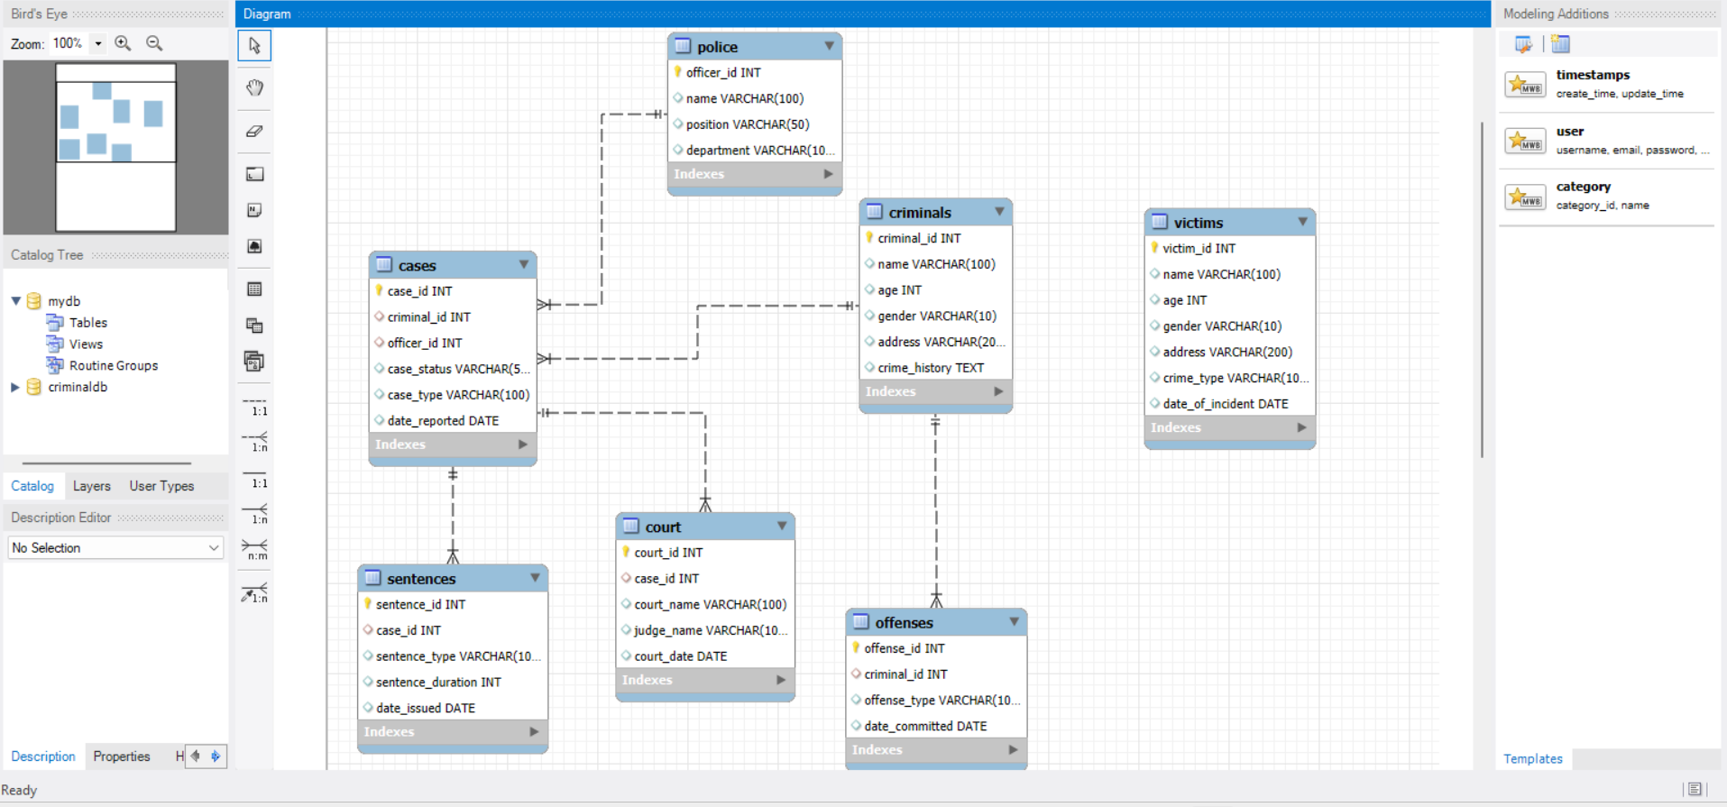
Entity Relationship Diagram

Slide 7
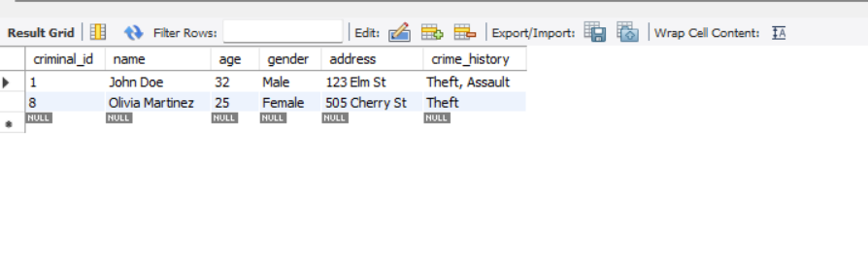
Query And Solutions
# Problem: Find the details of all criminals who have committed 'Theft'.SELECT * FROM Criminals WHERE crime history LIKE '%Theft%';

Slide 8
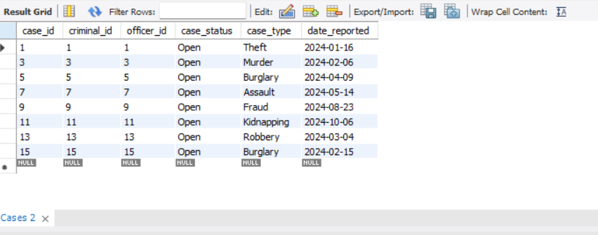
# Problem: Retrieve all cases where the status is 'Open'.SELECT * FROM Cases WHERE case_status = 'Open';

Slide 9
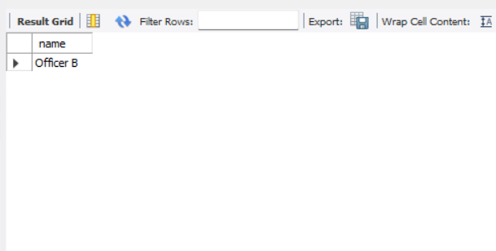
# Problem: Get the names of all police officers who are assigned to the 'Fraud Division'. SELECT name FROM Police WHERE department = 'Fraud Division';

Slide 10
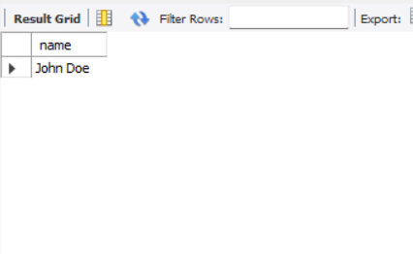
# Problem: List all the criminals who are assigned to the 'District Court A'.SELECT Criminals.name FROM CriminalsJOIN Cases ON Criminals.criminal_id = Cases.criminal_idJOIN Court ON Cases.case_id = Court.case_idWHERE Court.court_name = 'District Court A';

Slide 11
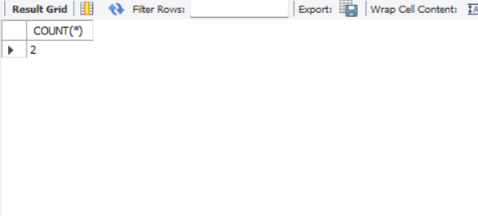
# Problem: Find the total number of victims who have been assaulted.SELECT COUNT(*) FROM Victims WHERE crime_type = 'Assault';

Slide 12
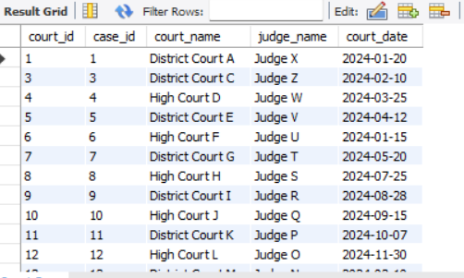
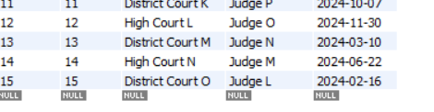
# Problem: Get all court details for cases reported after '2024-01-01'.SELECT * FROM Court WHERE court_date > '2024-01-01';

Slide 13
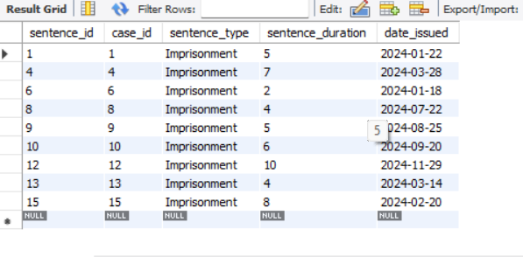
# Problem: List all the sentences issued for 'Imprisonment'. SELECT * FROM Sentences WHERE sentence_type = 'Imprisonment';

Slide 14
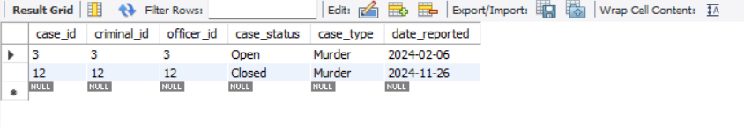
# Problem: Find the case details for all 'Murder' cases.SELECT * FROM Cases WHERE case_type = 'Murder';

Slide 15
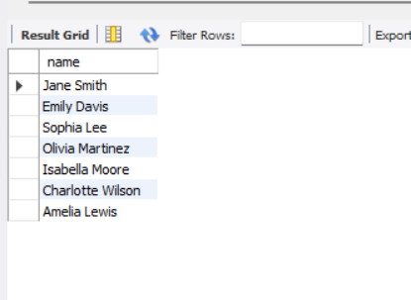
# Problem: Retrieve the criminal information for those convicted in 'High Court' courts.SELECT Criminals.name FROM CriminalsJOIN Cases ON Criminals.criminal_id = Cases.criminal_idJOIN Court ON Cases.case_id = Court.case_idWHERE Court.court_name LIKE '%High Court%';

Slide 16
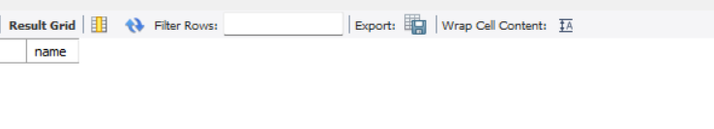
# Problem: Get the names of criminals who have committed both 'Robbery' and 'Assault'.SELECT name FROM Criminals WHERE crime_history LIKE '%Robbery%' AND crime_history LIKE '%Assault%';

Slide 17
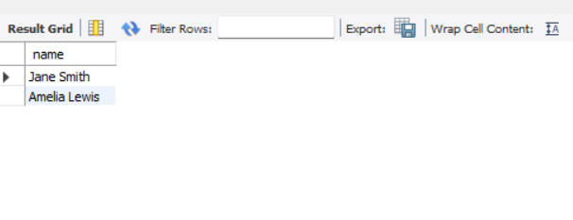
# Problem: Find the criminals whose cases have a 'Closed' status and have received a 'Fine' sentence. SELECT Criminals.name FROM CriminalsJOIN Cases ON Criminals.criminal_id = Cases.criminal_idJOIN Sentences ON Cases.case_id = Sentences.case_idWHERE Cases.case_status = 'Closed' AND Sentences.sentence_type = 'Fine';

Slide 18
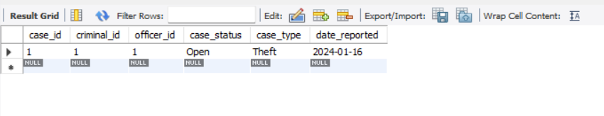
# Problem: List all the cases handled by the officer 'Officer A'.SELECT * FROM Cases WHERE officer_id = 1;

Slide 19
Conclusion
The Criminal Database Management System (CDMS) is a transformative solution for modernizing the way criminal records and cases are managed. By centralizing data, automating processes, and providing real-time access to critical information, the system significantly enhances the efficiency of law enforcement, judicial proceedings, and interagency collaboration.
With features like secure data handling, role-based access control, and advanced analytics, CDMS not only streamlines investigations and case tracking but also aids in crime prevention by analyzing patterns and trends. Additionally, it ensures transparency, accountability, and fairness in the criminal justice process, fostering trust among stakeholders.
In conclusion, the Criminal Database Management System is an indispensable tool for creating a safer society, empowering authorities with data-driven insights, and ensuring justice is delivered swiftly and effectively.

Slide 20
Thank-You

